Slide 1
Proposal for a Situational Data Model & Notation Specification
Update for BMI and the Healthcare DTF
Office of Knowledge Based Systems
Office of Informatics and Information Governance, VHA
23 September, 2019

Slide 2
Agenda
Introduction
What is Situational Data?
Situational Data Context
SDMN Metamodel Review
Conclusions

Slide 3
Introduction
We will refer to the combined standards of BPMN, CMMN, and DMN as “BPM+”
This presentation introduces a proposal for a new BMI standard to be added to the “BPM+” stack: Situational Data Model and Notation (SDMN)
This proposal has been generated from the work being done in the BPM+ Health efforts
  Example shown will be from that work

Slide 4
What is Situational Data?
Situational Data is the set of Data Items and their structures that are needed for the performance and understanding of a Knowledge Package Model.
  The details of the Data Items will usually be a subset of the “official” complexity of those items in the environment of the Knowledge Package Model.
    For example, the official definition of the Data Item for Blood Pressure (in healthcare) includes more than 50 properties. A Data Item in a Situational Data Model may need only 2 of those properties for execution of the Processes, Cases, and or Decision Services.
  Semantic References can be added to link the Data Item to the “official” details.
Uses of the Data Items in BPM+ models that determine the scope of Situational Data include:
  Data required for DMN Decisions
  Data required for BPMN Gateways transitions
  Data required to be passed to/from services invoked by BPMN and CMMN
  Data required to trigger Sentries in CMMN
  Etc.

Slide 5
What is a Situational Data Model?
A Situational Data Model is a repository of Data Items to be used (referenced) by the other BPM+ Data Items:
  BPMN Data Objects, CMMN Case File Items, DMN Data Inputs, etc.
The Data Items can be created once and maintained in a single location instead of creation and maintenance distributed across multiple models.
A Situational Data Model is a model because there are relationships between the Data Items (e.g., parent-child).

Slide 6
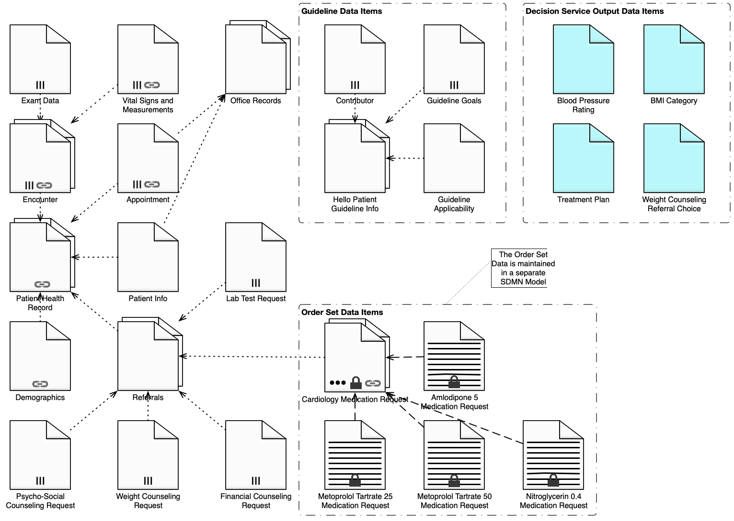
Situational Data Model Example

Slide 7
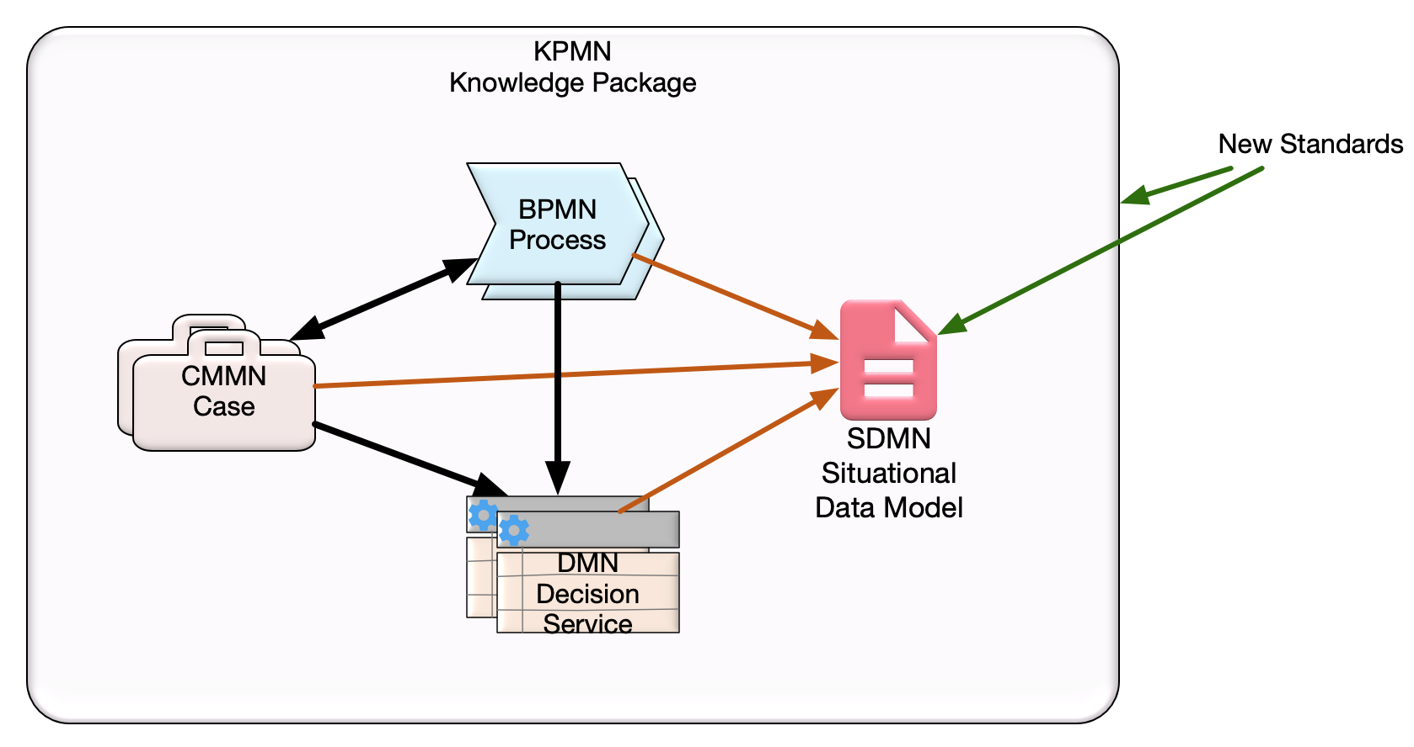
The Situational Data Context

Slide 8
The Situational Data Context, cont.
A Situational Data Model is part of a larger structure known as a Knowledge Package Model that contains models of Processes, Cases, and Decision Services
  The other BPM+ models utilize the Data Items in the Situational Data Model

Slide 9
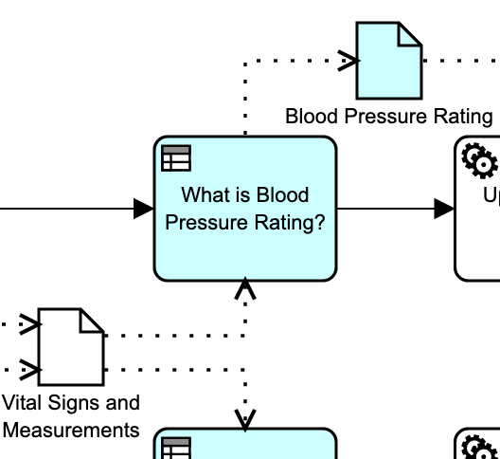
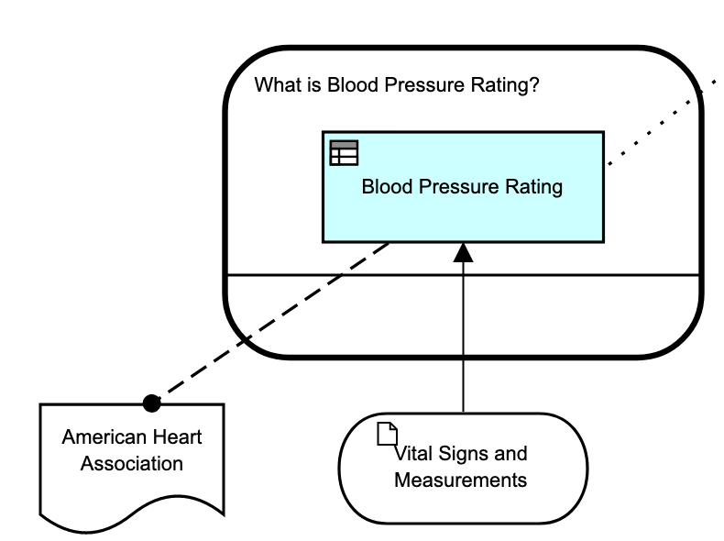
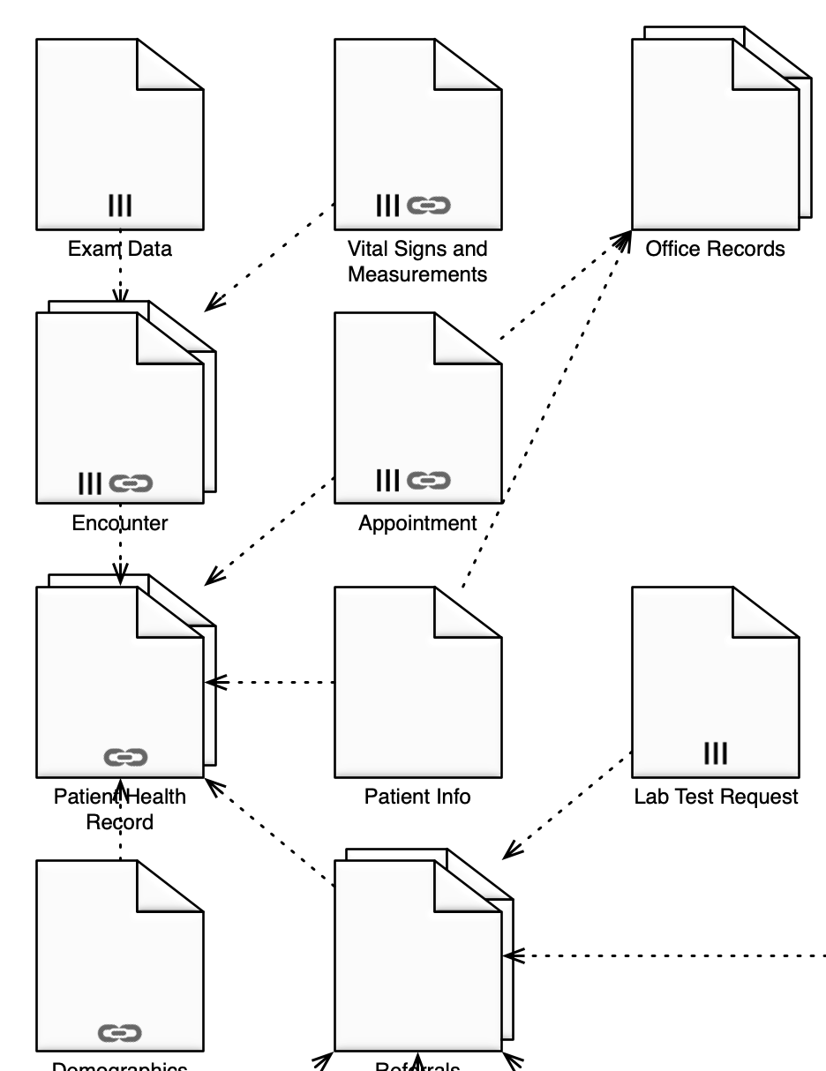
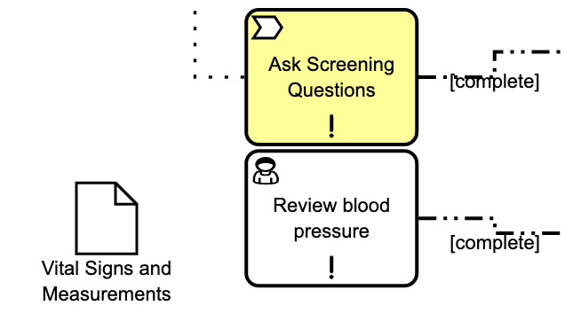
Utilizing Situational Data
The Situational Data Model will provide Data Items for each Process Data Object, Case File Item, and Decision Input.
  The Data Items will be defined once in the Situational Data Model and used in multiple BPM+ models.
SDMN
DMN
BPMN
CMMN
Notes:
CMMN Data ExampleCMMN Data Example

Slide 10
Review of SDMN Metamodel
Core SDMN elements
Situational Data Model Elements
ItemDefinition Elements
Situational Data Model Metadata

Slide 11
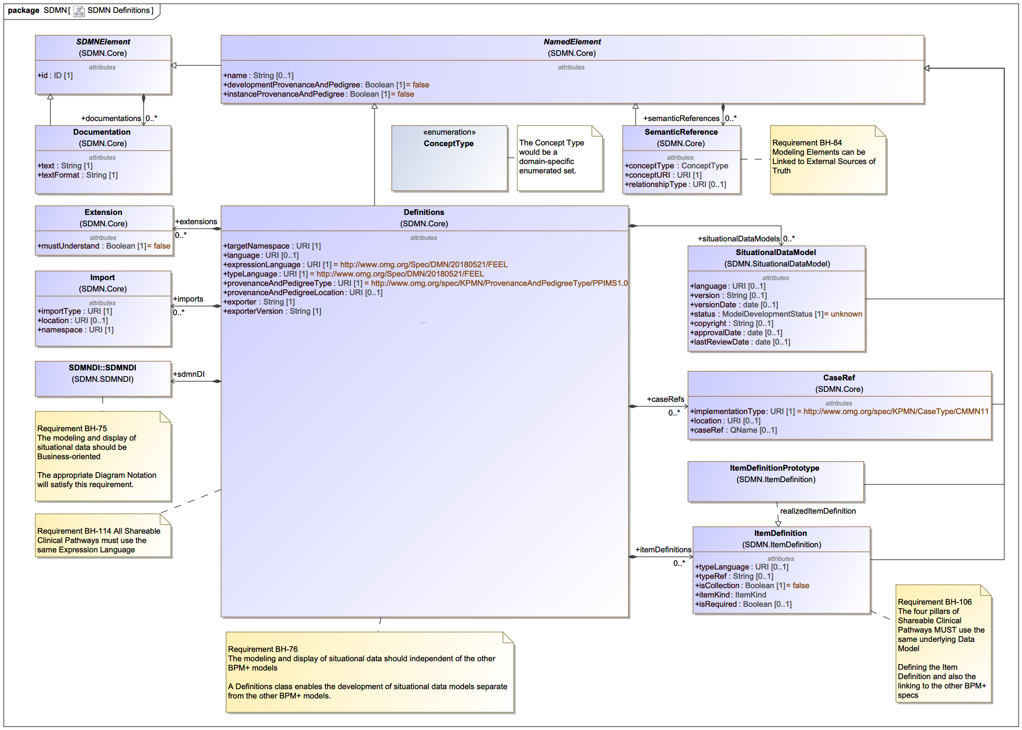
Core SDMN Elements

Slide 12
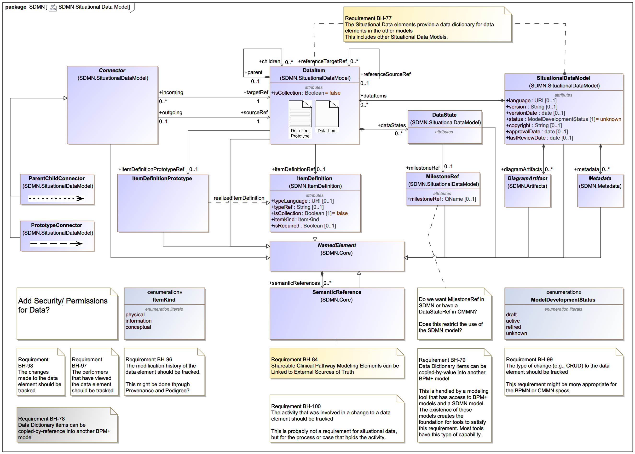
Main Situational Data Model Elements

Slide 13
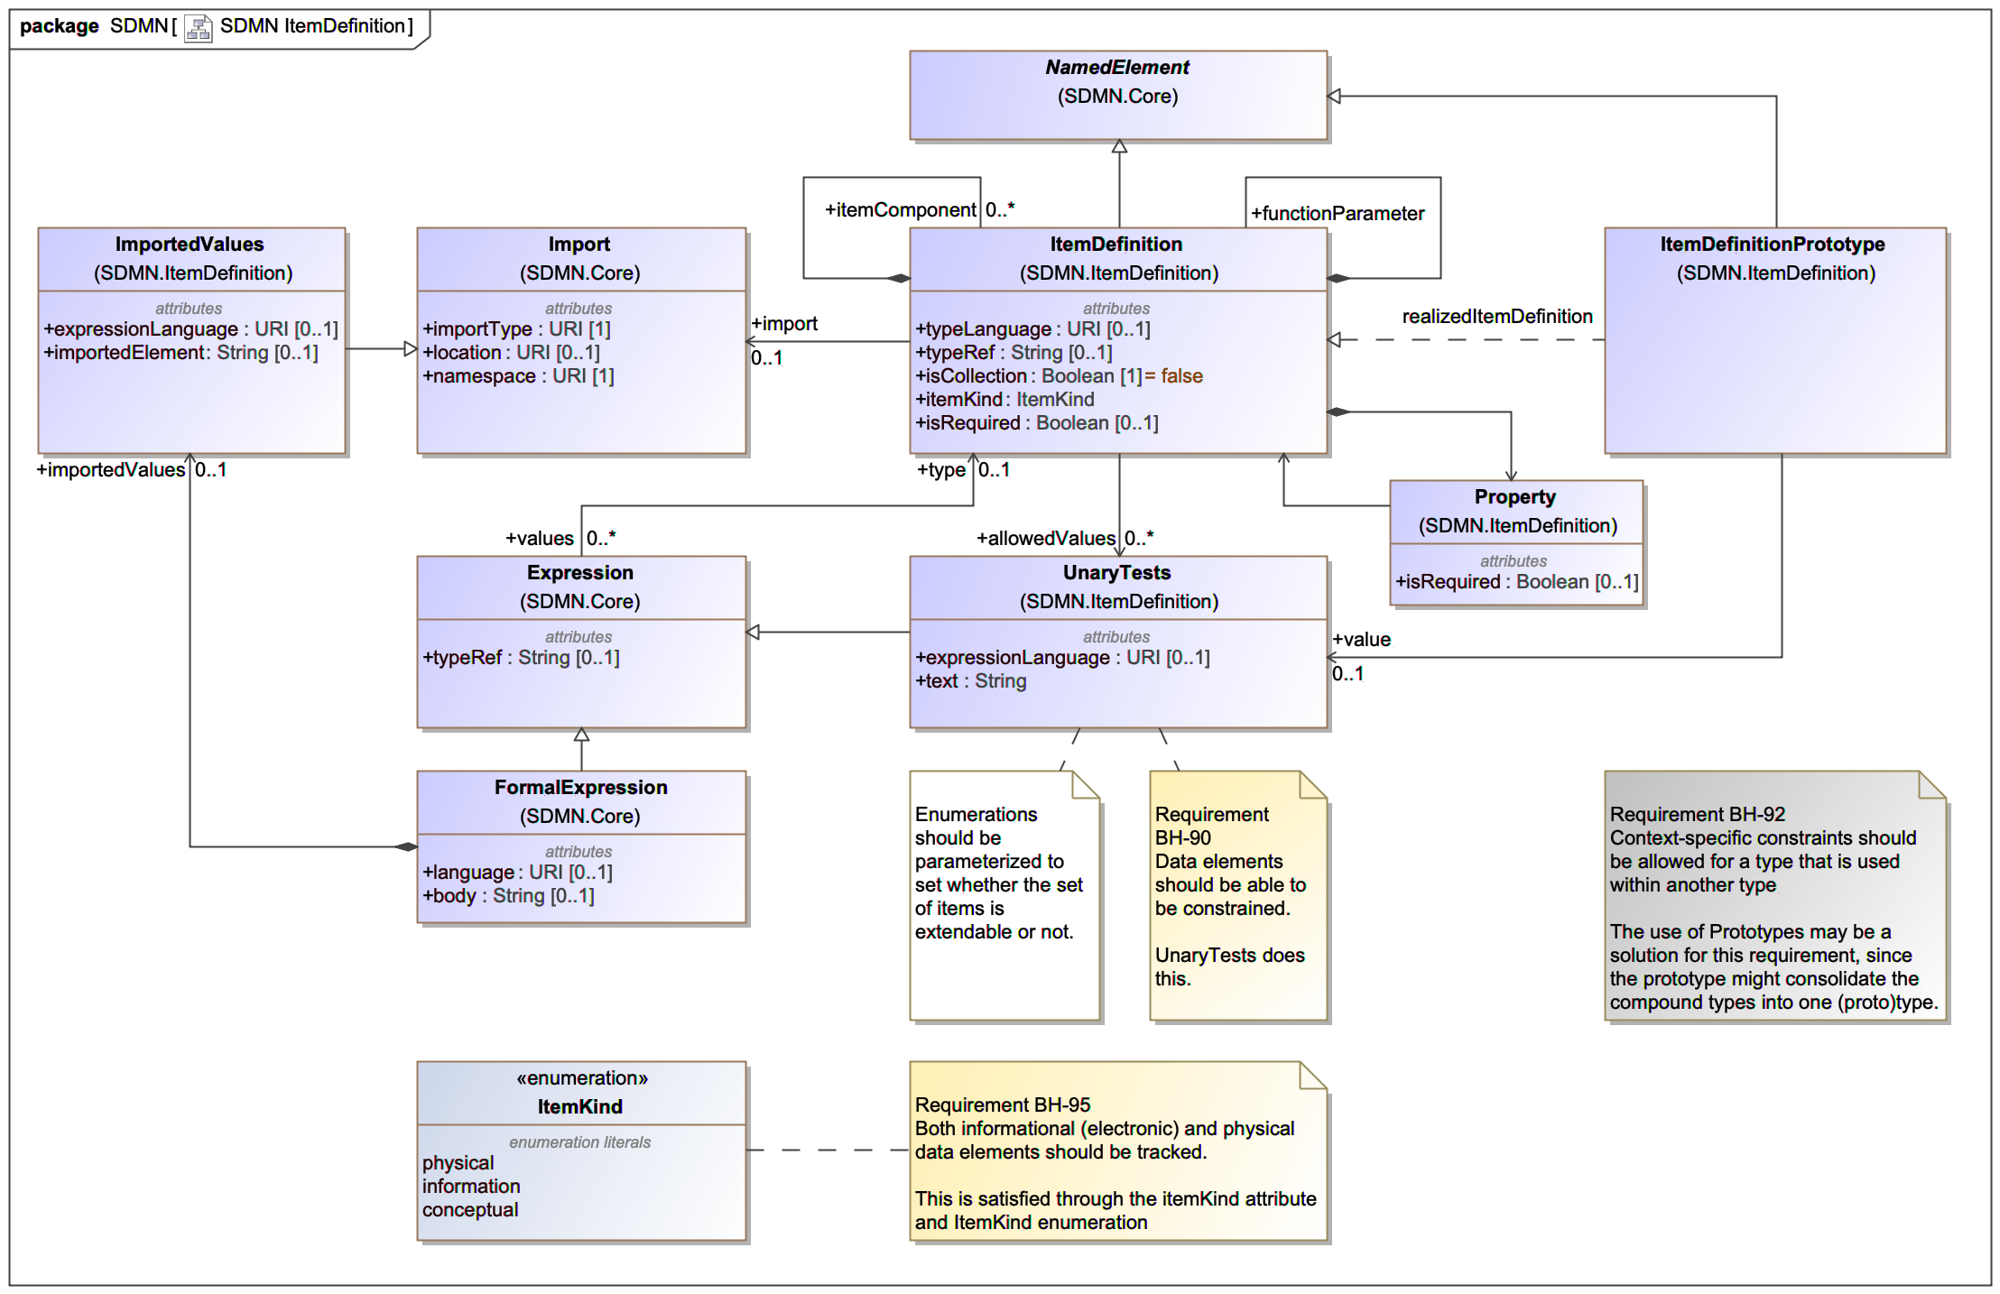
Situational Data Item Definition

Slide 14
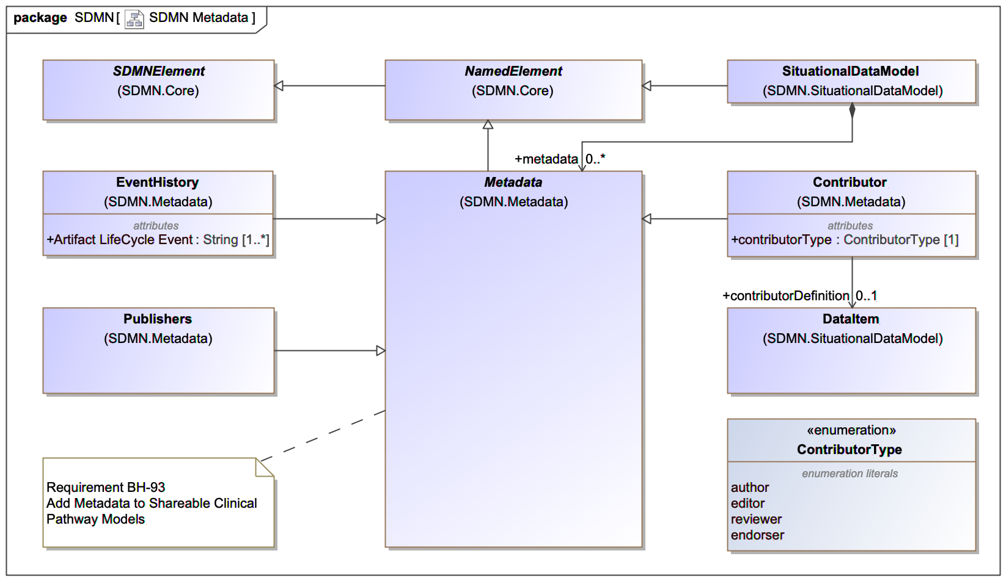
Situational Data Metadata

Slide 15
Implications for the OMG Standards
The harmonization of BPMN, CMMN, and DMN effort, which was present 1 year ago, is still important, but not the focus of this presentation.
  There are implications for the harmonization effort to allow the BPM+ models utilize the Situational Data Model Data Items.
We plan to develop a full SDMN specification for submission to BMI
  We should have a draft to review in December
A Knowledge Package Model and Notation (KPMN) will also be developed and submitted to BMI

Slide 16
Conclusions
SDMN will provide a library of Data Items that can be referenced by other BPM+ models
  These Data Items will be realized as BPMN Data Objects, CMMN Case File Items, and DMN Data Inputs, etc.
SDMN will provide a diagram that will illustrate the Data Items and their relationships

Slide 17
Questions?

