Slide 1
Proposed Changes for UAF v1.3
Services
  Services Domain
  Service Mitigation
  Services as Agents
Performers and Agents
  Capabilities and Effects
  Architecture is Not an Agent/Performer
  Operational Scenarios as Agents
  Trustlines Between Operational Performers
NATO Architecture Framework
  NATO Information Element Mapping
  Operational Nodes & Needlines
  Mission and Mission Threads
  Location Types (eg, Platform)
Informative Components
  NATO Framework Guide for UAF
  Sample Model Updates
  EA Guide Updates
Metamodel and Modeling
  Add Use Cases
  Measurements (Typical & Actual)
  Architectural Description & Referencing
  Portfolio as Enduring Object
  Upper Ontology (IDEAS vs BFO vs TBD)
Views & Grid
  Architecture Management Views
  Actualization Viewpoint & Views
  Structural & Behavioral Column
  Grouping in the Grid
  Strategic Viewpoint Designator (St→Sg)
Editorial & Other
  ISO Document Structure, Formatting & Style
  Alignment with ISO 42010-2022
  BAH Issues (see separate file)

Slide 2
Actualization Viewpoint & Views
Actual Resources domain covers more than just instances from the Resources domain
  Also covers instances from the Personnel domain (ie, Post, Organization, Person, Responsibility)
Suggest changing name to Actualization
  Or perhaps merely “Actuals”?
  Or perhaps “Instantiations”?
  Better represents what is going on here
Should this be a column instead?
  Matthew has ideas about this…

Slide 3
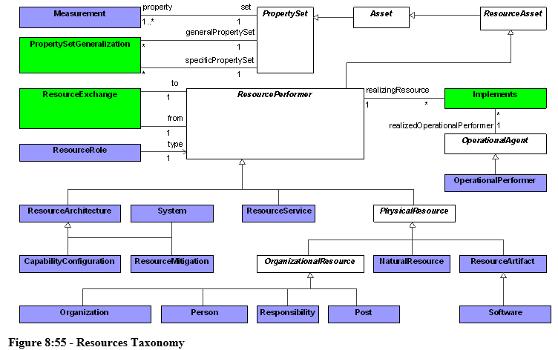
Resources & Personnel
Note that Organizational Resource is a specialization of Resource Performer
But Personnel viewpoint is shown above the Resources viewpoint in the Grid
Therefore, should swap these two rows in the Grid to more consistently follow general pattern that top to bottom in Grid represents “layers of abstraction”

