Slide 1
Proposed Changes for UAF v1.3
Services
  Services Domain
  Service Mitigation
  Services as Agents
Performers and Agents
  Capabilities and Effects
  Architecture is Not an Agent/Performer
  Operational Scenarios as Agents
  Trustlines Between Operational Performers
NATO Architecture Framework
  NATO Information Element Mapping
  Operational Nodes & Needlines
  Mission and Mission Threads
  Location Types (eg, Platform)
Informative Components
  NATO Framework Guide for UAF
  Sample Model Updates
  EA Guide Updates
Metamodel and Modeling
  Add Use Cases
  Measurements (Typical & Actual)
  Architectural Description & Referencing
  Portfolio as Enduring Object
  Upper Ontology (IDEAS vs BFO vs TBD)
Views & Grid
  Architecture Management Views
  Actualization Viewpoint & Views
  Structural & Behavioral Column
  Grouping in the Grid
  Strategic Viewpoint Designator (St→Sg)
Editorial & Other
  ISO Document Structure, Formatting & Style
  Alignment with ISO 42010-2022
  BAH Issues (see separate file)

Slide 2
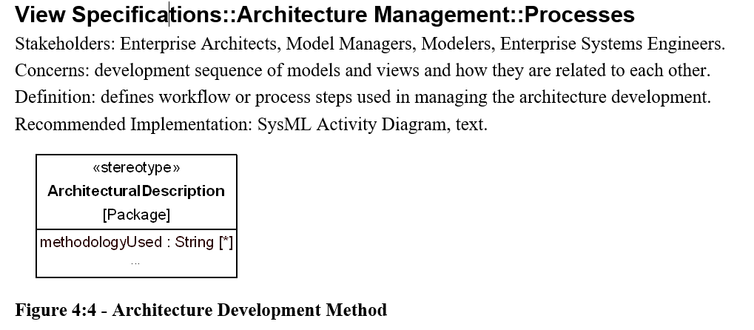
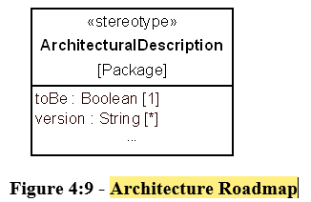
Architecture Management Views
One of the AM views shown in the Grid does not have corresponding View Specifications in UAFML: Architecture Taxonomy: Architecture Extensions
AM Processes view
  Should be more than just identification of a methodology (Besides, a methodology is not a process…). Should allow for capturing a process-like diagram.
AM States view
  This should show more than merely “Status”.
  Should be a view showing the progression of
  maturity states for the architecture
AM Roadmap view
  Should be more than indication of ToBe or not ToBe.
  Should be a timeline of planned/expected
  evolution of the architecture IAW defined
  states and transitions in States view.
  Versions should correspond to which
  capabilities, missions, actual measurements, etc will be achieved for that version

