Slide 1
Proposed Changes for UAF v1.3
Services
  Services Domain
  Service Mitigation
  Services as Agents
Performers and Agents
  Capabilities and Effects
  Architecture is Not an Agent/Performer
  Operational Scenarios as Agents
  Trustlines Between Operational Performers
NATO Architecture Framework
  NATO Information Element Mapping
  Operational Nodes & Needlines
  Mission and Mission Threads
  Location Types (eg, Platform)
Informative Components
  NATO Framework Guide for UAF
  Sample Model Updates
  EA Guide Updates
Metamodel and Modeling
  Add Use Cases
  Measurements (Typical & Actual)
  Architectural Description & Referencing
  Portfolio as Enduring Object
  Upper Ontology (IDEAS vs BFO vs TBD)
Views & Grid
  Architecture Management Views
  Actualization Viewpoint & Views
  Structural & Behavioral Column
  Grouping in the Grid
  Strategic Viewpoint Designator (St→Sg)
Editorial & Other
  ISO Document Structure, Formatting & Style
  Alignment with ISO 42010-2022
  BAH Issues (see separate file)

Slide 2
NATO Architecture Framework

Slide 3
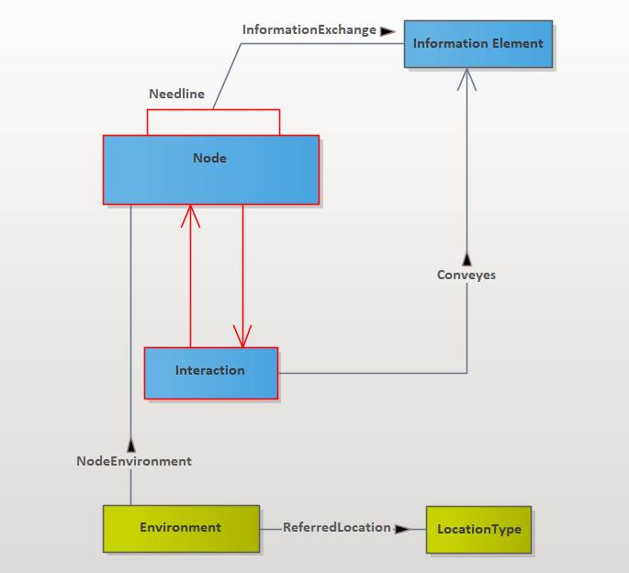
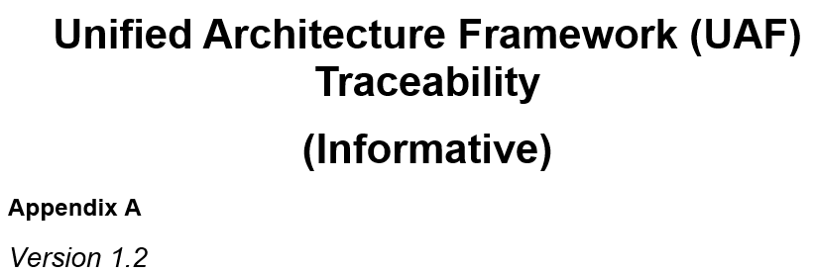
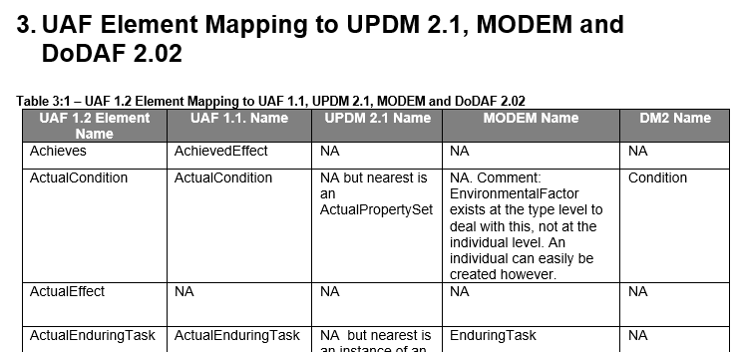
NATO Information Element Mapping
NAF no longer has its own Metamodel in NAFv4, instead relying upon the UAF Domain Metamodel
However, NAF now includes an Information Model
Therefore, the UAF Appendix A on Traceability should provide a mapping from UAF model elements to the NAFv4 Information Elements
  Similar to the UAF Element Mapping to UPDM, etc:
Example graphic from NAF Information Model

Slide 4
Operational Nodes
There is a need to add “Operational Node” to UAF; but also “needline” with regards to “capabilities”. These 3 concepts work together in a coherent way:
  “Capability” is, of course, an ability to perform an action.
  “Node” is an ability to instantiate one or more operational unit being resource, location and/or organizational unit.
  “Needline” is an ability to exchange something (ie, information, people, energy, goods, etc.) between nodes.
The “logical specification” of NAFv4 cannot be described without these 3 concepts (In particular, the views related to the L1..L8 viewpoints.
Notes
  The same need can be considered with NAFv3 (views related to NOV-2..NOV-6) and UPDM (See the “Node” and “Needline”).
  Absence of “Node” and “Needline” in UAF provides a huge compatibility problem with UPDM, NAFv3 and NAFv4 because the “Logical Specification” cannot be described. For this reason, I currently encourage Architects working with OMG-related environment to not only consider UAF; but also consider UPDM being more compatible with NAF.

Slide 5
NAF “Needline” Concept
NAFv4
Needline is missing in the official delivery of the NAFv4 Information Model. A change request is currently being processed.
“Needline” is in the NAFv4 Information model (version 2022-02-07)
In UAF the Operational Connector is equivalent to the NAF Needline
  This can be explained in EA Guide for UAF
  Also, can be explained in a NAF Guide for UAF

Slide 6
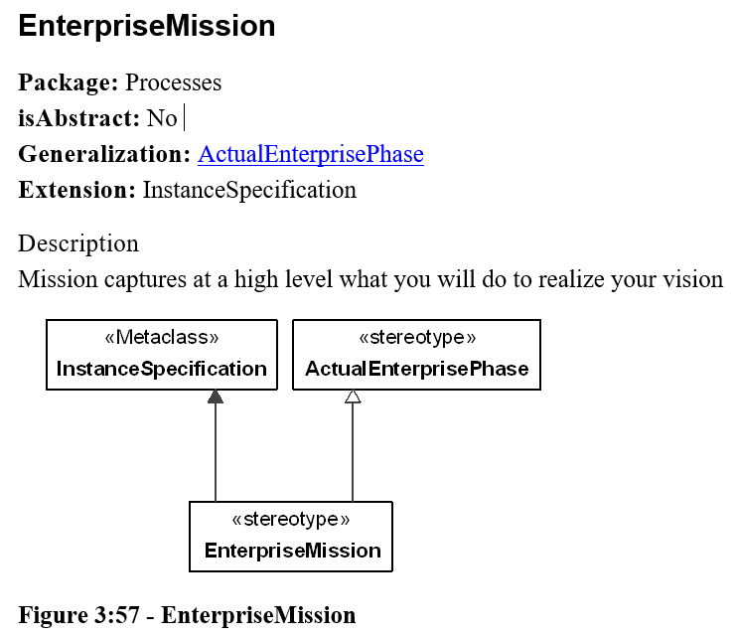
Mission: Architecture Traceability (wrt Mission)
In what sense is a Mission some kind of Enterprise Phase?
  Why is it Enterprise Mission and not merely Mission?
  Seems like an Enterprise conducts a Mission or has a Mission
Mission definitions in dictionary:
  An aerospace operation intended to carry out specific program objectives: a mission to Mars.
  A special assignment given to a person or group: an agent on a secret mission.
  A combat operation assigned to a person or military unit.

Slide 7
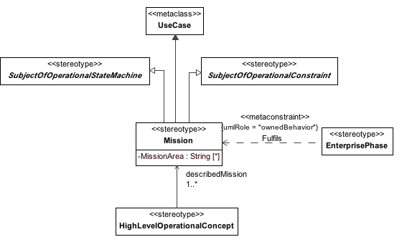
Mission
“Mission” was dropped because MODAF dropped Missions object
A Mission summarizes the goals and objectives of the mission. It describes the purpose along with the intended action.
  MODAF:A purpose to which a person, organization or autonomous system is tasked.
  DoDAF: An objective together with the purpose of the intended action. (Extension of DDDS 1(A)) Note: Multiple tasks accomplish a mission. (Space and Naval Warfare Systems Command) Needline - requirement that is the logical expression of the need to transfer information among nodes.
  CADM: (1/3) (A) The task, together with the purpose, that clearly indicates the action to be taken.
Figure 1 – Elements related to the Mission stereotype.
Attributes
The following are attributes of Mission:
MissionArea : String[*] - The area in which the Mission will take place.
Extensions
The following are extensions for Mission:
UseCase

Slide 8
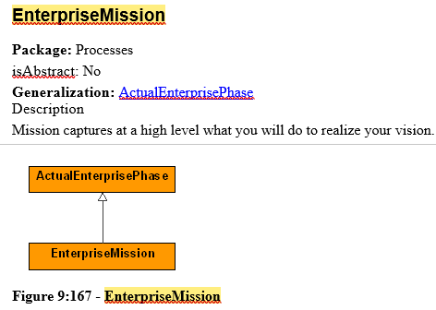
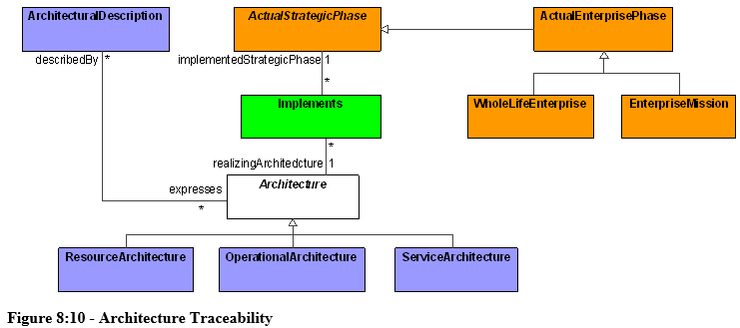
Mission and Mission Threads
These concepts are often used in enterprise and SOS modeling
  No standard way to model these in UAF
  Added “Enterprise Mission” in UAF v1.2, but this does not seem satisfactory to deal with this concept

Slide 9
Summary & Overview (wrt Mission)

Slide 10
Strategic Processes (wrt Mission)

Slide 11
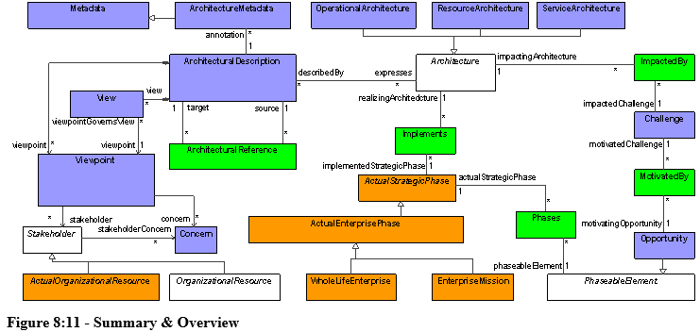
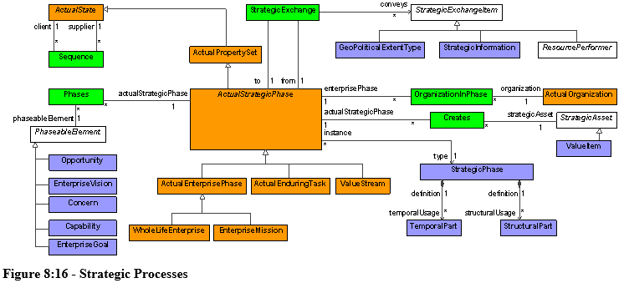

Slide 12
Mission Threads
There is no Operational Roadmap view
  This is where an Operational Phase could appear
  Also, would need Operational Phase structure?
Could be related to mission threads in NATO Mission Thread Guide
  Need more information from JL Garnier on this

Slide 13
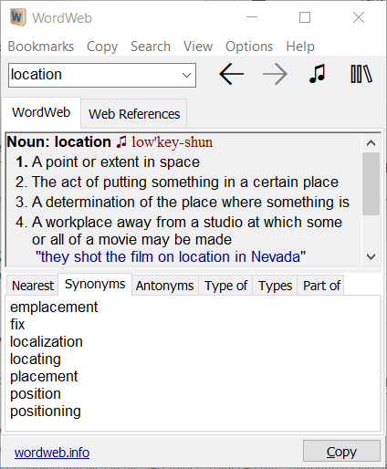
Location Types (eg, Platform)
Location
  Package: Parameters
  isAbstract: No
  Generalization: ConceptItem, Condition
  Description
  A specification of the generic area in which a LocationHolder is required to be located.
LocationHolder
  Package: Parameters
  isAbstract: Yes
  Generalization: UAFElement
  Description
  Abstract type, used to group elements that are allowed to be associated with a Location.
Notice that location is “determination” of the “place where something is”. Would Place be more accurate term for Location Holder concept?

Slide 14
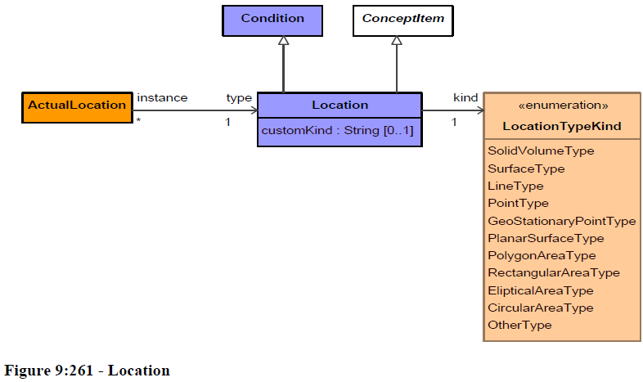
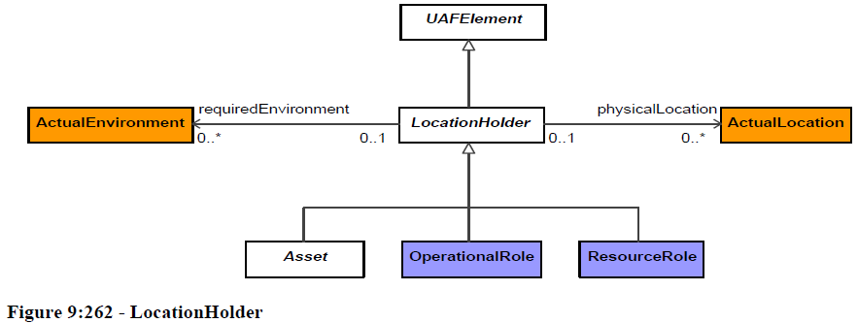
Location Types (eg, Platform)
Need a concept for a
Place Object?

Slide 15
Difference Between Location and Place
Differentiating the terms “location” and “place” is a bit difficult to state in words, most especially that the two have been used interchangeably by many. This comes as no surprise since most resources define “location” as “a type of place” while some definitions of “place” appear to be a type of locality, which is still very related to the term “location.” Nevertheless, the two must be understood as two different concepts.
Foremost, “place” is described as “an area that usually has indefinable margins or borders.” In its most generic description, a place is like a segment of space. In another sense, a place can be any building that has definite purpose like how the church is being described as a place of worship. A place can also be any spot or area where a person or persons live. So, when one says to you “Let’s go to my house” he is referring to his house as the place where both of you should go.
Moreover, a place can also be used more figuratively rather than literal as in the sentence, “Put yourself in his place and I’m sure you’ll understand!” In this connection, the term “place” is used to refer, not to a particular area in space, but to the situation where the other person is in. “Place” can also be used to describe a certain point system that bears several stages like the one having the most points being in the first place, followed by the second place, and so on and so forth. In mathematics, “place” can also refer to a certain position in a series. So, in the series “1, 3, 5, 7…” number 3 is in second place.
By contrast, “location” is different from “place” because you tend to be more specific with the area where a certain spot is situated. Thus, when you’re told about a location, it often comes with an implied idea that you should know where or how to locate that spot. Using one of the examples above, when one says to you “Let’s go to my house,” you can ask for the location of his place by asking him where exactly that house is situated. When he answers, “My house is at 289 Red Street…” then he is already telling you of its exact location. Thus, location is something that is described with absolute coordinates (latitudes, longitudes, street numbers, etc.) or with reference to something like [next to or close to something else] “My house is to the right of the bookstore.”
http://www.differencebetween.net/language/words-language/difference-between-location-and-place

Slide 16
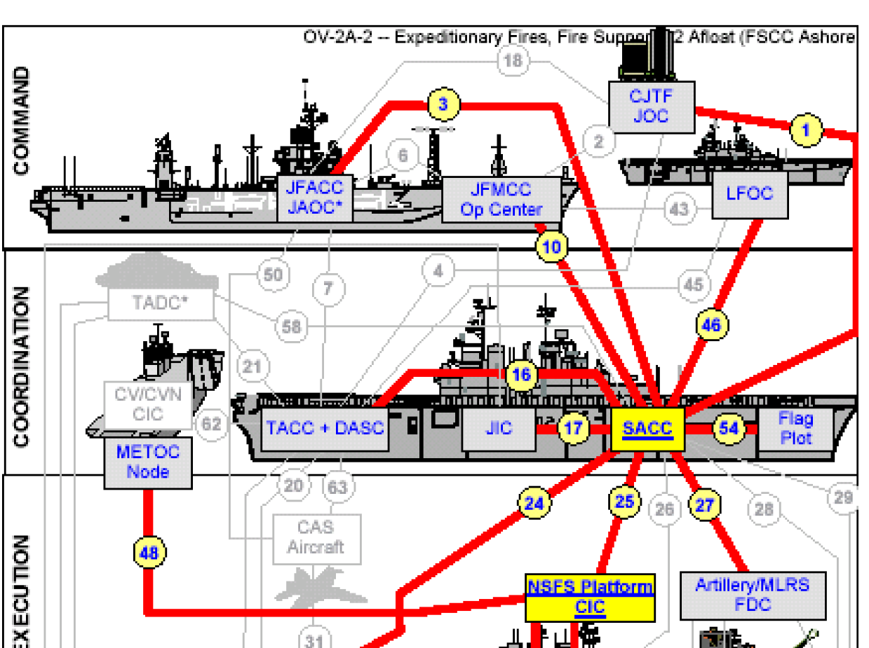
Location Types (eg, Platform)
What is operational significance of these Operational Nodes?
  Is a Ship an Operational Performer?
  Can a Ship perform Operational Activities?
  A ship is more often thought of as a Platform which carries something (eg, sensor, ops center, weapon)
A Platform could be thought of as a special case of a “Location”
  Platform can be defined as a “foundation or base”
  “where someone stands”
Other Nodes here can be thought of as “Organizational Nodes”
  Joint Operations Center
  Command Center
  Central Information Center

Slide 17
Proposal: Add Platform & Organizational Location objects
Location is kind of Location “Node” in NAF
Need to make Location abstract.
Need a way to capture idea of a “place” (eg, headquarters) that is not a specific instance of something but rather a place that “has a definite purpose” or a place that is responsible in an organizational sense
X
kind
Organizational Location
Physical Location
Platform
A Platform is a special kind of Location where something is mounted or situated (eg, sensors, weapons, op center). Note that an Organizational Location can be part of a Platform.
Current concept of Location is only about “geophysical” parameters as noted in the Location Type Kinds listed here. Suggest making Physical Location be a subtype of Location and make Location abstract.

