Slide 1
Proposed Changes for UAF v1.3
Services
  Services Domain
  Service Mitigation
  Services as Agents
Performers and Agents
  Capabilities and Effects
  Architecture is Not an Agent/Performer
  Operational Scenarios as Agents
  Trustlines Between Operational Performers
NATO Architecture Framework
  NATO Information Element Mapping
  Operational Nodes & Needlines
  Mission and Mission Threads
  Location Types (eg, Platform)
Informative Components
  NATO Framework Guide for UAF
  Sample Model Updates
  EA Guide Updates
Metamodel and Modeling
  Add Use Cases
  Measurements (Typical & Actual)
  Architectural Description & Referencing
  Portfolio as Enduring Object
  Upper Ontology (IDEAS vs BFO vs TBD)
Views & Grid
  Architecture Management Views
  Actualization Viewpoint & Views
  Structural & Behavioral Column
  Grouping in the Grid
  Strategic Viewpoint Designator (St→Sg)
Editorial & Other
  ISO Document Structure, Formatting & Style
  Alignment with ISO 42010-2022
  BAH Issues (see separate file)

Slide 2
Capabilities and Effects
Capability as an “ability” to do something cannot DESIRE some State (or some Effect)
Only things with “agency” can “desire” something
  Agency is defined as “the means or mode of acting”
  Operational Agents and Resource Performers have the “means of acting” while a Capability does not
See next slide for recommended changes…
c

Slide 3
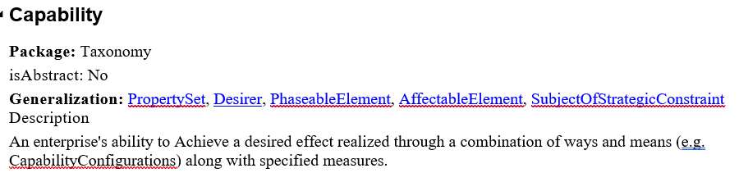
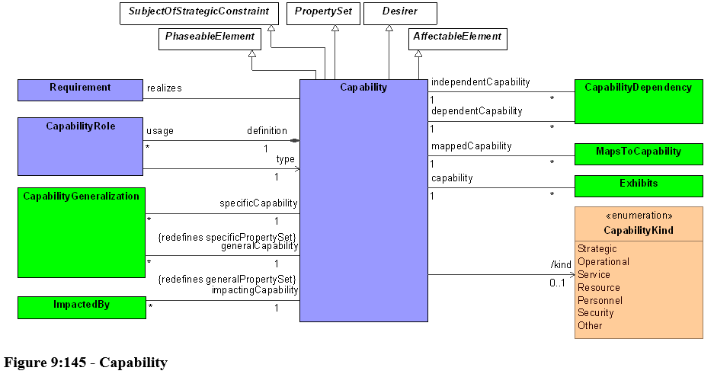

Slide 4
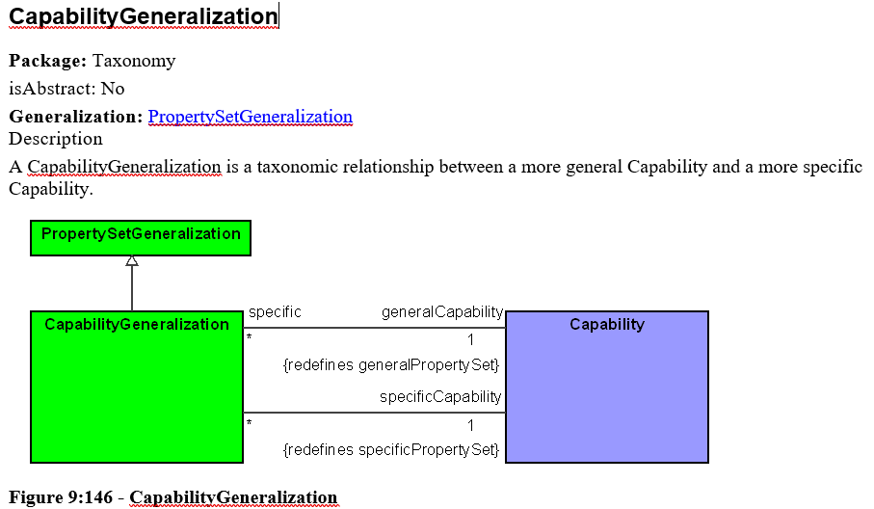
Capability Generalization

Slide 5
Capabilities and Effects
Only some kind of action can lead to Effects (ie, state changes)
  Drop Capability as a Desirer
  Add relationships as shown here: Leads to & Enables
(Leads to?) Enables
Capability
Exhibits
Leads to
Exhibits
Operational Activity
Exhibits
X
Function
Performs*
Performs*
* Specified as “is capable to perform”
Remove Capability as a Desirer
But link it to Actual State directly with Enables relationship as shown above

Slide 6
Architecture is Not an Agent/Performer
Architecture: fundamental concepts or properties of an entity in its environment and governing principles for the realization and evolution of this entity and its related life cycle processes [ISO 42010/42020]
  Can a set of concepts, properties and principles perform Activities or Functions? → NO
  An Architecture is the set of fundamental concepts or properties of an Agent or Performer
  Therefore, an Architecture can be neither an Agent nor a Performer
Other Questions
  Is an Operational/Resource Mitigation really a type of Operational/Resource Architecture?
  Is a Security Enclave really a type of Resource Architecture?
  Is a Capability Configuration really a type of Resource Architecture?
  Is a System really a type of Architecture? (No, a System <has an> Architecture)
Architecture
Has an
Configuration
------------------
Configuration
------------------
Operational Configuration
----------------------
Resource Configuration
----------------------

Slide 7
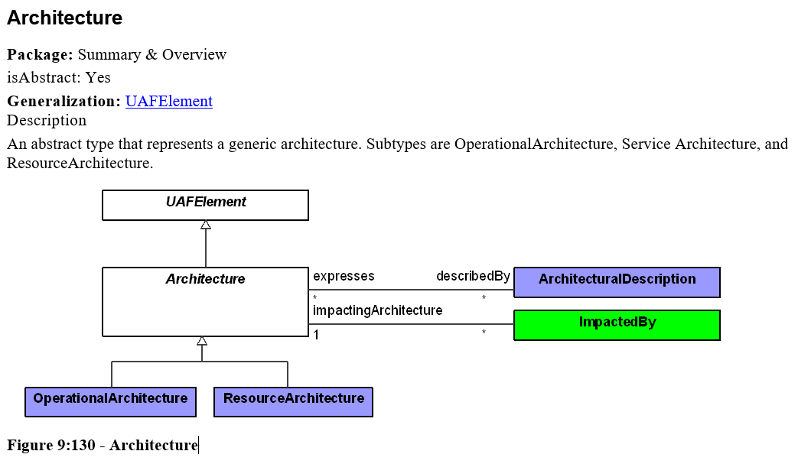
Architecture
Notice that Service Architecture is missing here

Slide 8
Architecture is Not an Agent/Performer
Even though an Architecture is not an Agent it should be a Capable Element that can exhibit a Capability
Operational Architecture
Operational Configuration
----------------------
An Architecture has no “agency”, i.e., it cannot do anything since it is a property of the thing that is being architected. Therefore, Architecture cannot be a kind of Operational Agent.
Change Operational Architecture to Operational Configuration
Make an Operational Architecture a Capable Element

Slide 9
Operational Scenarios as Agents
X
Operational Scenario
There is a need for the concept of Operational Scenario which can perform Operational Activities.
Many modelers use an Operational Architecture as the entity to capture notion of a Scenario or Vignette or Use Case

Slide 10
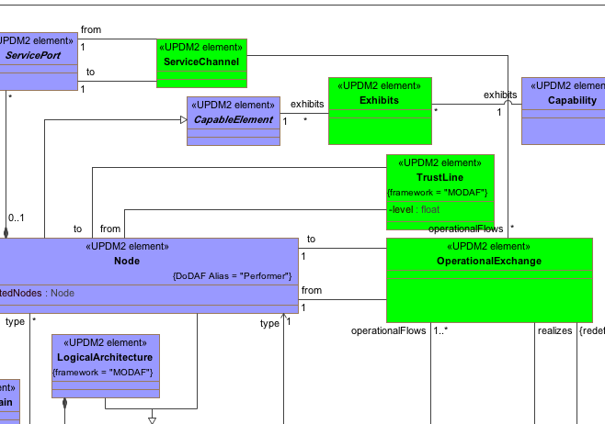
TrustLines Between Operational Performers
In UPDM, a TrustLine can connect two Nodes
  TrustLine can have a value for the level of trust to be expected
  In UAF, a Node is equivalent to Operational Performers
Therefore, in UAF need to add a TrustLine between Operational Performers

