Slide 1
Proposed Changes for UAF v1.3
Services
  Services Domain
  Service Mitigation
  Services as Agents
Performers and Agents
  Capabilities and Effects
  Architecture is Not an Agent/Performer
  Operational Scenarios as Agents
  Trustlines Between Operational Performers
NATO Architecture Framework
  NATO Information Element Mapping
  Operational Nodes & Needlines
  Mission and Mission Threads
  Location Types (eg, Platform)
Informative Components
  NATO Framework Guide for UAF
  Sample Model Updates
  EA Guide Updates
Metamodel and Modeling
  Add Use Cases
  Measurements (Typical & Actual)
  Architectural Description & Referencing
  Portfolio as Enduring Object
  Upper Ontology (IDEAS vs BFO vs TBD)
Views & Grid
  Architecture Management Views
  Actualization Viewpoint & Views
  Structural & Behavioral Column
  Grouping in the Grid
  Strategic Viewpoint Designator (St→Sg)
Editorial & Other
  ISO Document Structure, Formatting & Style
  Alignment with ISO 42010-2022
  BAH Issues (see separate file)

Slide 2
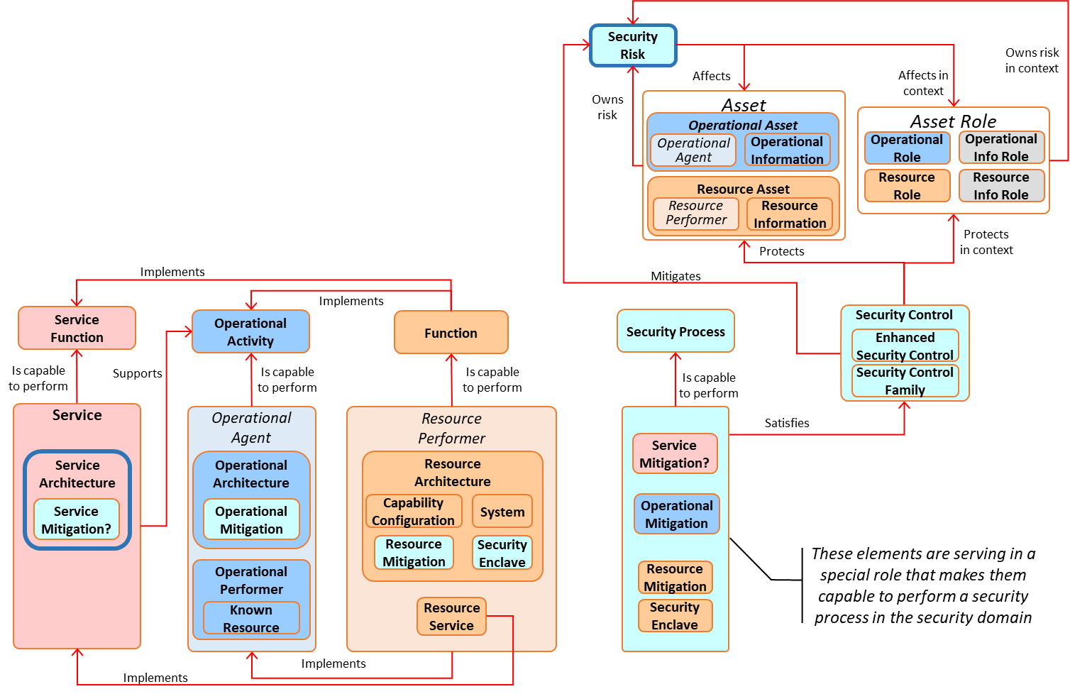
Service Mitigation
Needs to be a Service Mitigation (similar to Operational Mitigation and Resource Mitigation)
  There will be cases where a Service Architecture needs to include special ways to mitigate expected threats or risks to that Service
  Service Mitigation will be capable to perform a Security Process that deals with such a security threat
  Service Mitigation will satisfy the Security Control that needs to be put in place to protect the relevant Operational/Resource Assets

Slide 3
Services as Agents
Things with “agency” can “desire” something
  Agency is defined as “the means or mode of acting”
  Operational Agents and Resource Performers obviously have the “means of acting”
Services also have agency and therefore should be identified as Desirers
Service

Slide 4
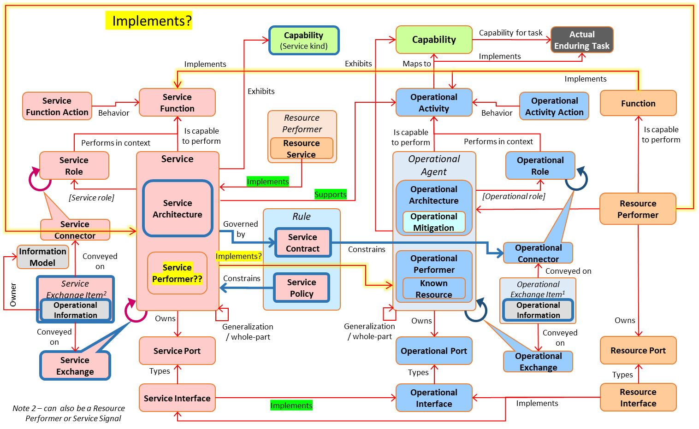
Services Domain
Should there be a Service Performer similar to the Operational Performer?
Can a Resource Performer implement a Service? (not only Resource Services)
Can a Service implement an Operational Agent? (equivalent to Service Interface)

